Slide 1
Deep Data Hack
TEAM MEGHDOOT
TEAM MEMBERS:-
PRATEEK KUMAR PRASAD (2301420018)
YATHARTH CHOPRA (2301420022)
AKSHAT SHARMA (2301420027)
# जय जवान जय किसान

Slide 2
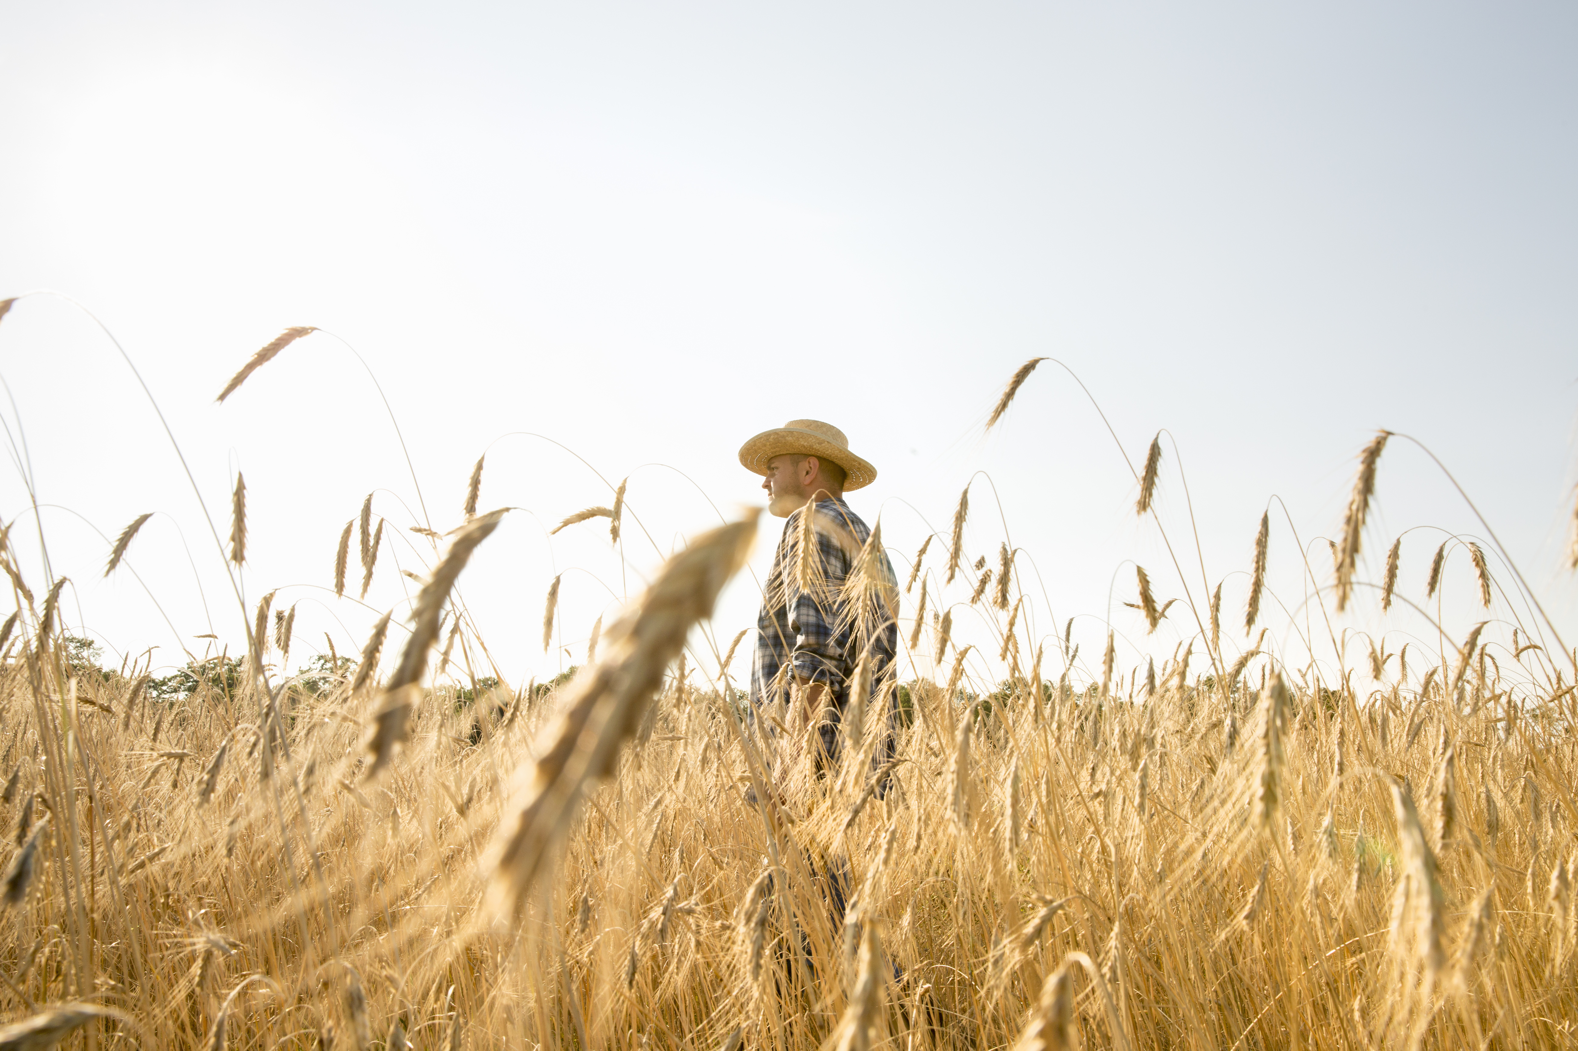
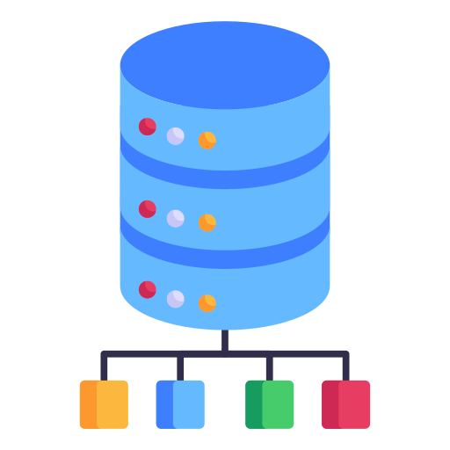
Problem & Goals
Problem: Farmers need to know how much crop they’ll get to plan better.
Dataset: 2.76 lakh rows (State, District, Crop, Area, Production, Yield).
Goal: Predict yield (exact number) + tell if it’s high or low for hackathon rules.

Slide 3
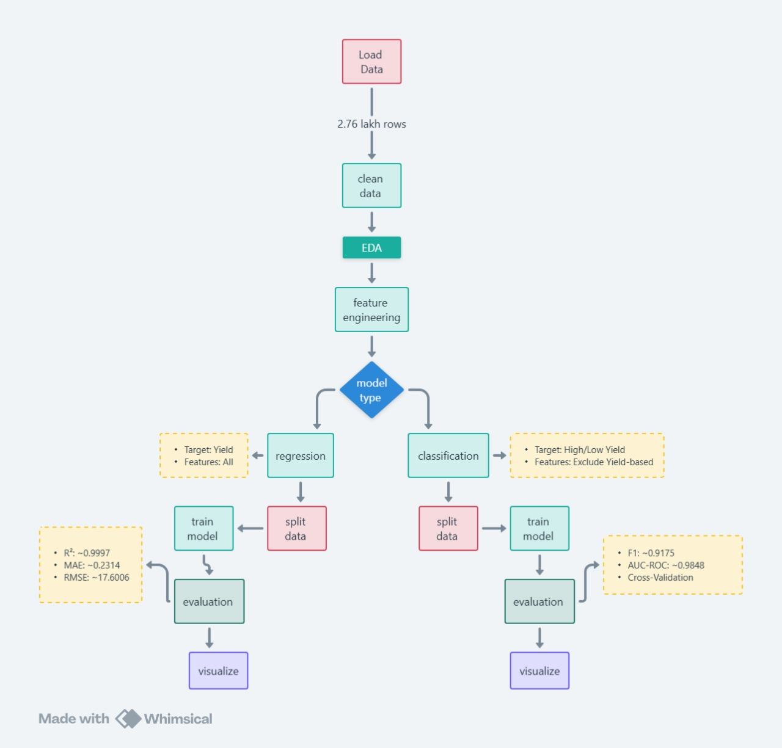






Flowchart & libraries
Libraries Used:
Python
Machine learning
Pandas
Google
Colab
NumPy
Scikit Learn

Slide 4
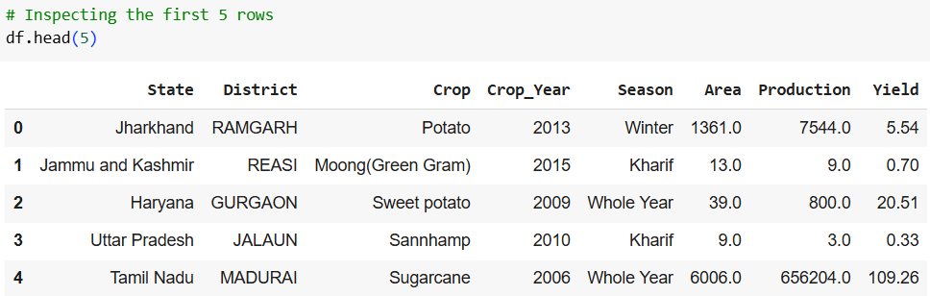
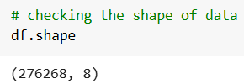
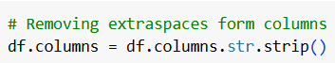
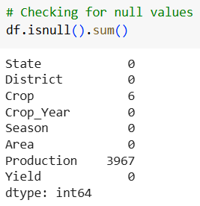
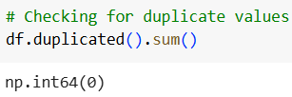
Dataset overview
Cleaned

Slide 5
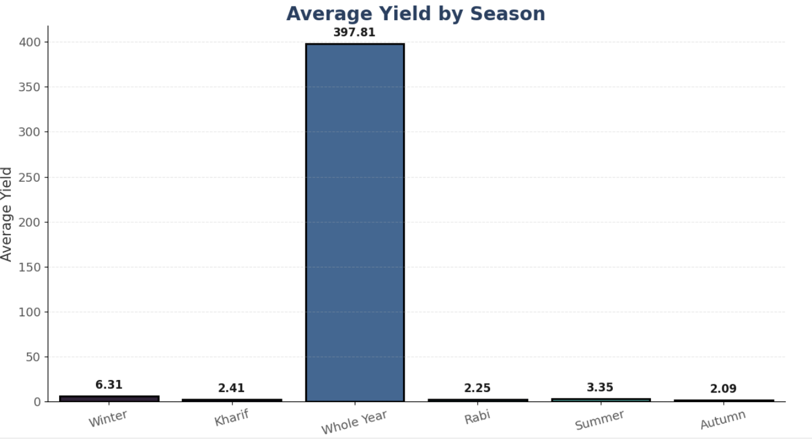
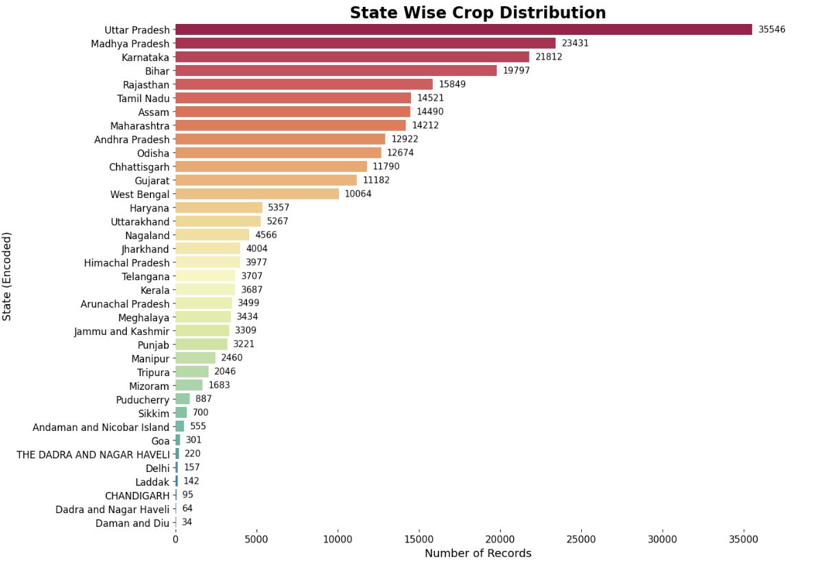
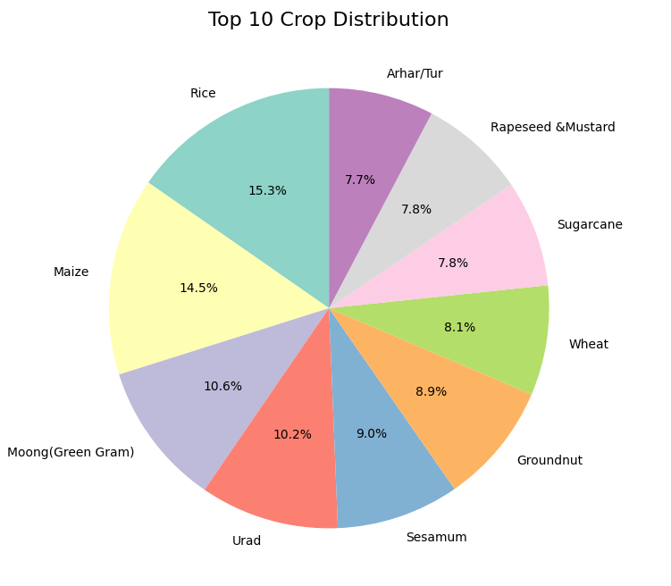
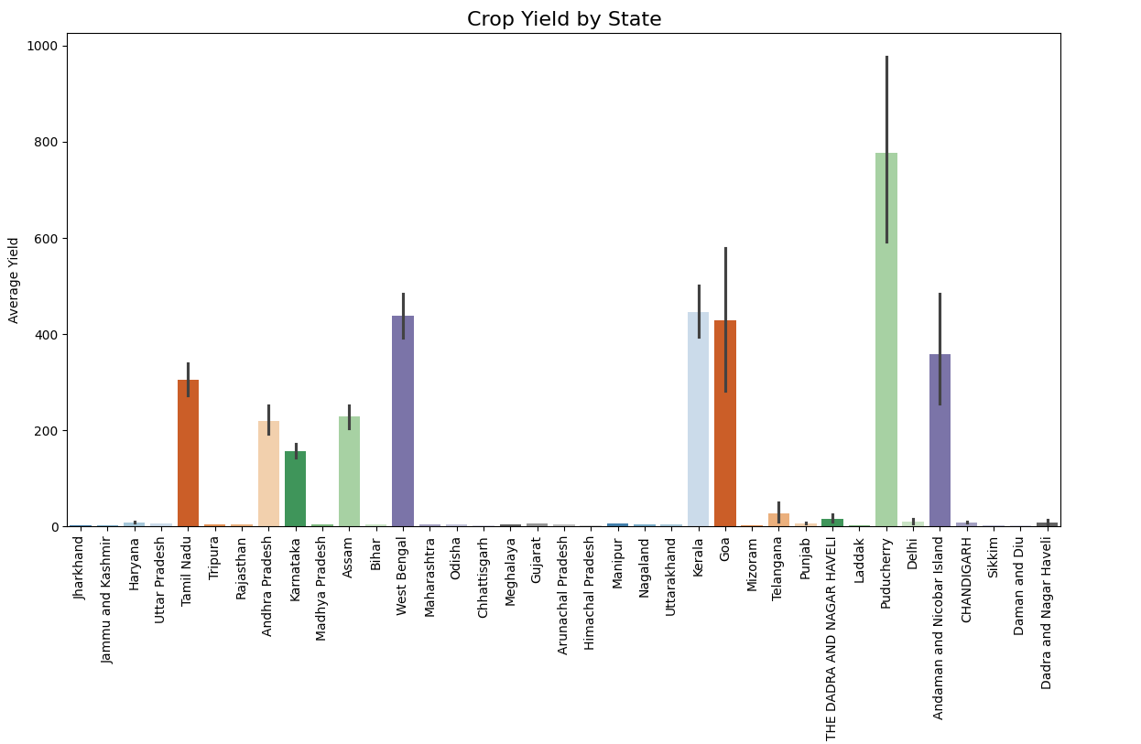
Regression analysis and model

Slide 6
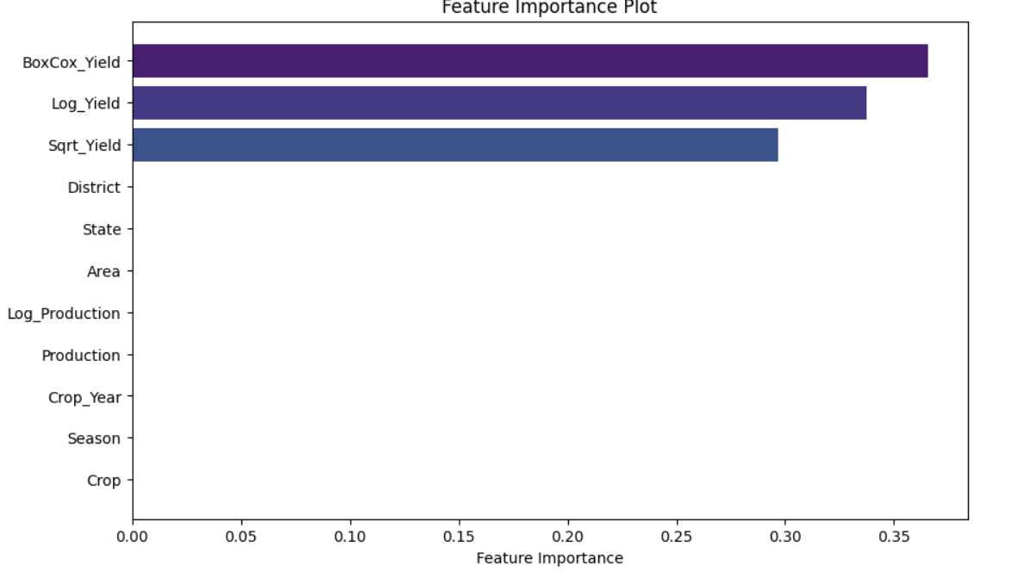
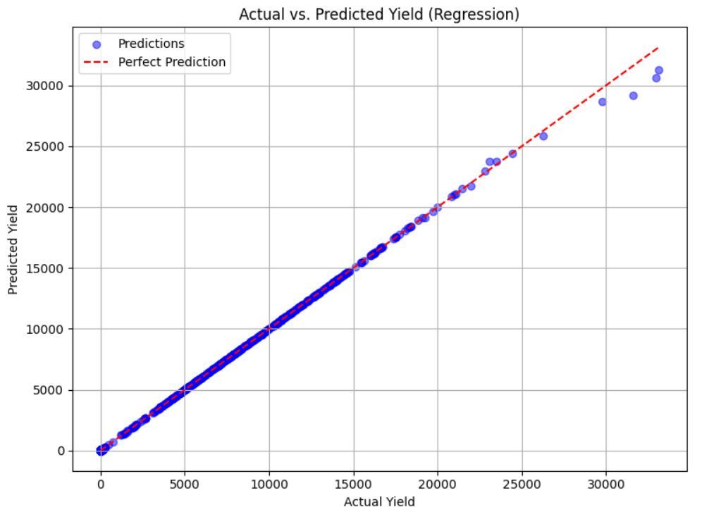
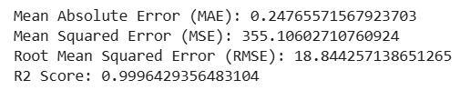
Regression analysis and model
Result of Random Forest model:

Slide 7
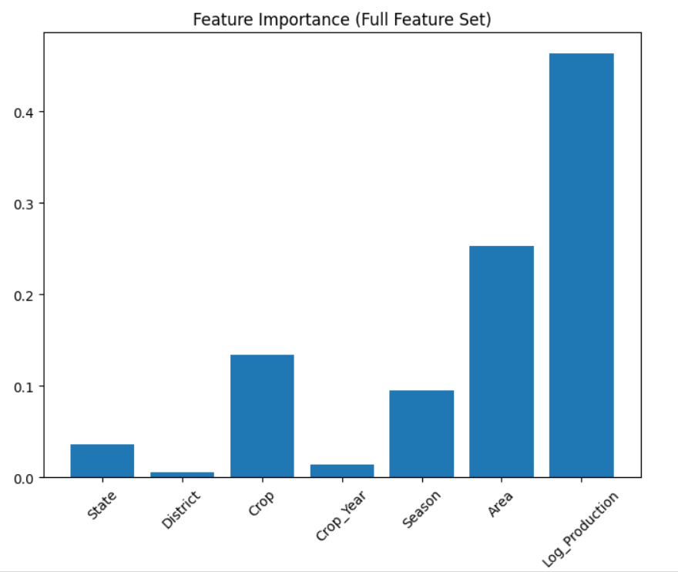
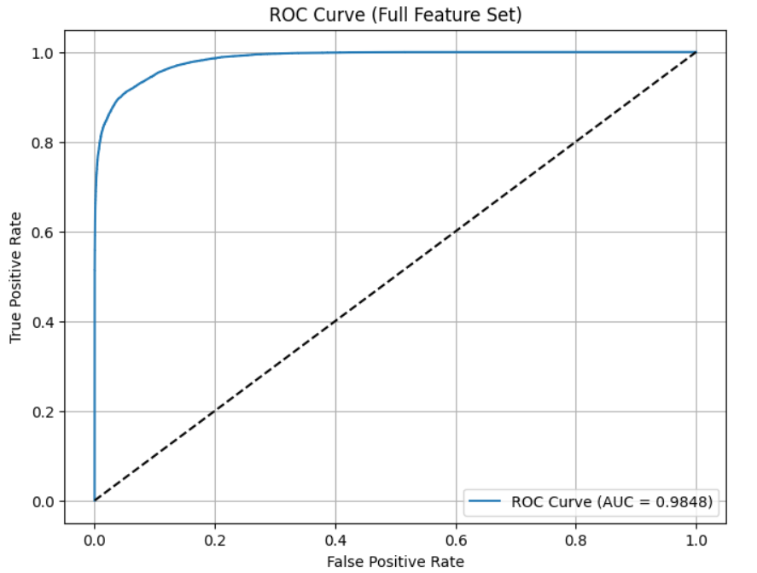
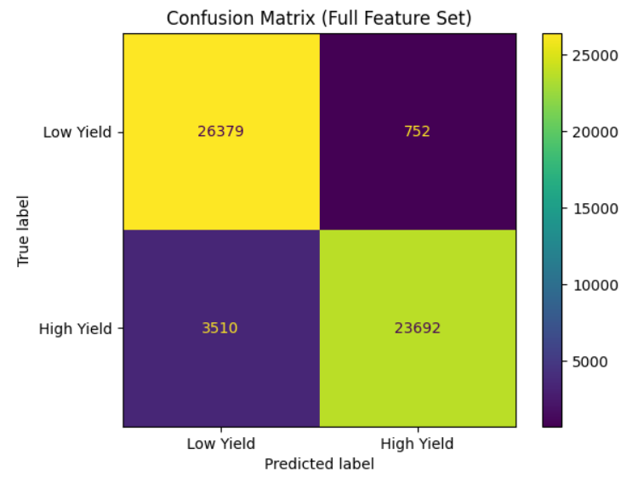
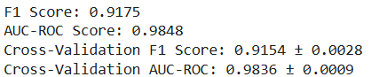
Classification analysis and model
Result

Slide 8

Git hub link
Click Here
https://github.com/yatharthchopra2424/Crop_Yeild_Analysis
Thank you!
# जय जवान जय किसान

